Slide 1


Wishlinx: My web app project
Name: Nwenyi Oluchi Jessica Program: BSc. Computer Science Matriculation No: 92126120
Course: Java and Web Development (DLBCSPJWD01) Github Repo: https://github.com/LuluNwenyi/Wishlinx Live Link: https://wishlinx.vercel.app

Slide 2
1
Project Overview
Wishlinx makes gift-giving easier for special occasions such as birthdays, baby showers, weddings, and more.
By sharing a wishlist with friends and family, Wishlinx takes the guesswork out of gift-giving, ensuring everyone gets exactly what they want. It's a win-win for gift-givers and recipients too!

Slide 3
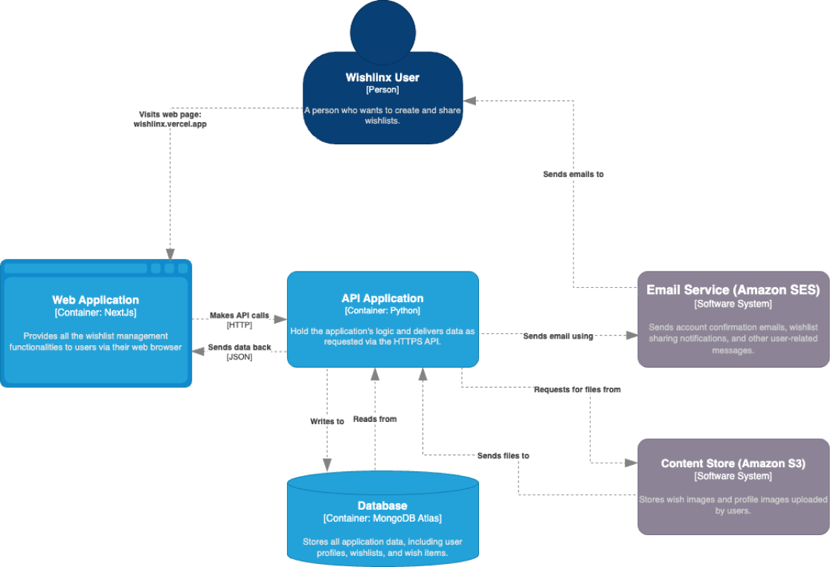

2
Architecture
Figure 1
An architectural diagram of Wishlinx

Slide 4
3
Tech stack breakdown
Frameworks
Design - Figma
Frontend - NextJs (React, CSS)
Testing - Postman
Backend - Python
Hosting
Frontend - Vercel
Backend - AWS EC2 (via Appliku)
Database - MongoDB
Messaging server - AWS SES
Content store - AWS S3

Slide 5
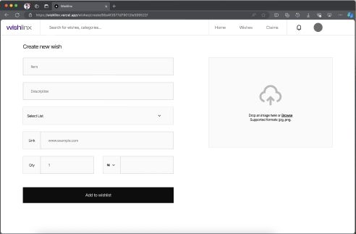


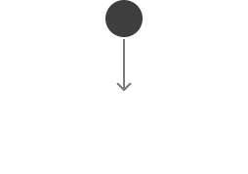
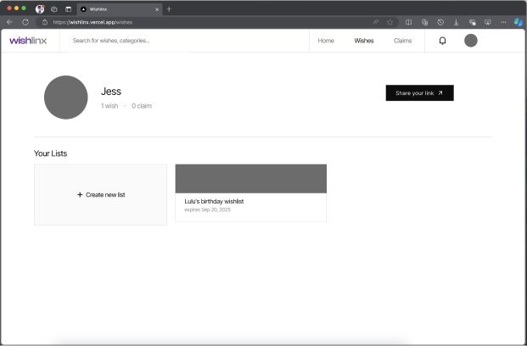


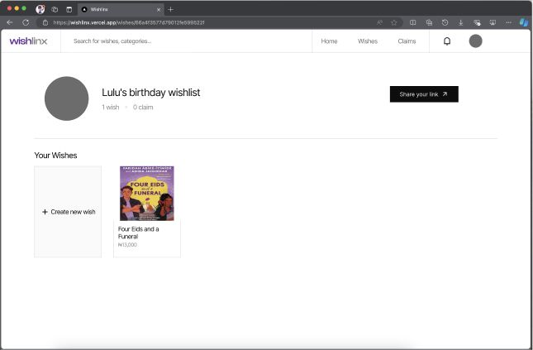


4
App in Action
4
input form when creating a wish
7
field for uploading image
3
2
button to share public profile with wishlists
navigation
1
a wishlist
6
interface for a wishlist
5
card component for each wish inside a list (with image)

Slide 6
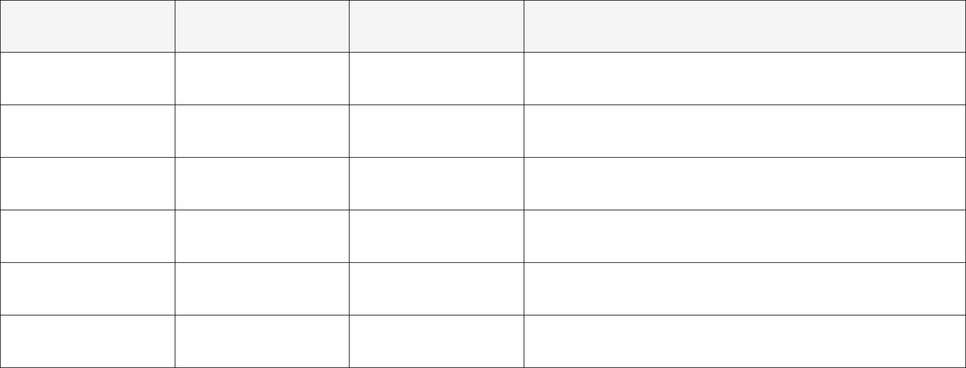
5
Architecture Changes
Phase 1
Phase 2
Why
Client-side Framework
HTML, CSS
NextJs, (React, CSS)
For improved performance and maintainability with more modern development practices.
Client-side Hosting
Netlify
Vercel
Best option for Next.js and had a free version.
Server-side Hosting
Firebase
AWS EC2 (Free Tier)
EC2 provided more control and flexibility over infrastructure with better scalability options.
Containerisation
Docker
-
Simpler deployment without the added complexity of managing containers.
Content Store
-
Amazon S3 (Free Tier)
It wasn’t initially considered, but i needed to store images.
Messaging Server
SendGrid
AWS SES (Free Tier)
Didn’t get SendGrid approval, and SES allowed free emails in staging.

Slide 7

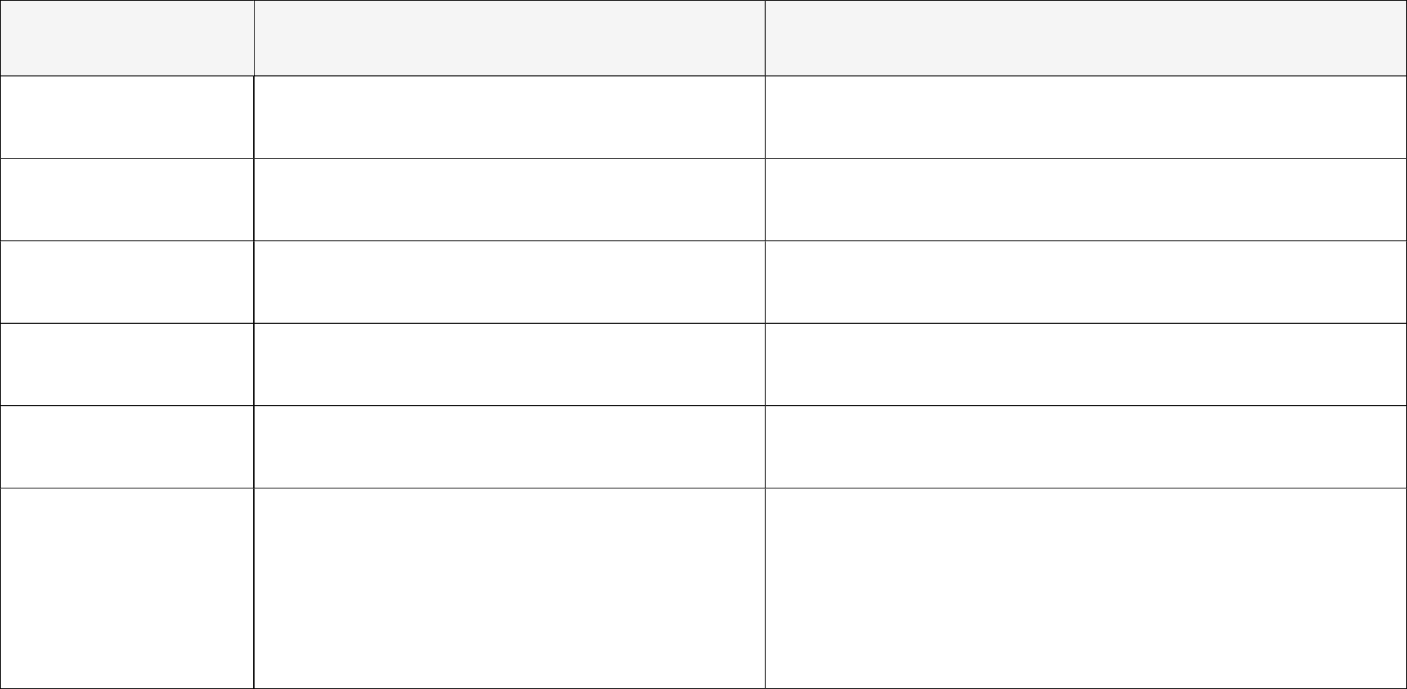
6
Test Cases
Action
Expected Result
User Registration
Fill out the registration form with valid data and click "Sign Up."
User account is created, and a confirmation email is sent by AWS SES.
User Login
Enter valid credentials and click "Login."
User is logged in, and the homepage is displayed.
Create Wishlist
Click "Create new list," fill out the form, and click "Create List."
Wishlist is saved to MongoDB and displayed on the user's dashboard.
Add wish to wishlist
Open a wishlist and click "Create new wish." Fill in the details and click "Add to wishlist."
Item is added to the wishlist and stored in MongoDB.
Share Wishlist
Click "Share your link" and enter the link in a browser.
Public view of the user’s profile is displayed with their wishlists.
A confirmation message appears, stating, "You’re fulfiling wishes!”, and the wish's status is updated in MongoDB to reflect that it has been claimed. An email notification is sent to the wishlist owner, and the person who made the claim, informing them that the wish has been claimed.
Claim a wish
Select any wish in a wishlist, fill out the claim form, and click “Claim.”

Slide 8
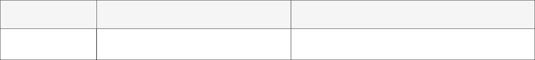


7
Test Cases
Action
Expected Result
See claimed wishes
Go back to the user’s profile to see what wishes are available.
The wish is marked as "Claimed" in the wishlist, preventing other users from claiming the same wish.
Test Data
Data
Data
Registration & Login
Name: Jane Username: jane Email Address: jane-wishlinx@maildrop.cc Password: password Go to maildrop.cc to view the mailbox
Create Wishlist
Title: Jane’s 30th Birthday Description: All Jane wants and more... Category: Birthday Expiry Date: 21-09-2025

Slide 9

8
Test Data
Data
Data
Add wish to wishlist
Item: Bluetooth Speaker Description: A portable Bluetooth speaker for outdoor use. List: Select “Jane’s 30th Birthday” Link: https://example.com/bluetooth-speaker Quantity: 1 Amount: $50 Image: Use any image
Claim a wish
Name: John Email Address: wishlinx@maildrop.cc Go to maildrop.cc to view the mailbox

Slide 10
9
Conclusion
Though the basic end goal of this project was achieved, as I continued to work on this project, I realised more room for improvement on the original idea of the project. The development phase has been a continuous learning experience for me.

Slide 11
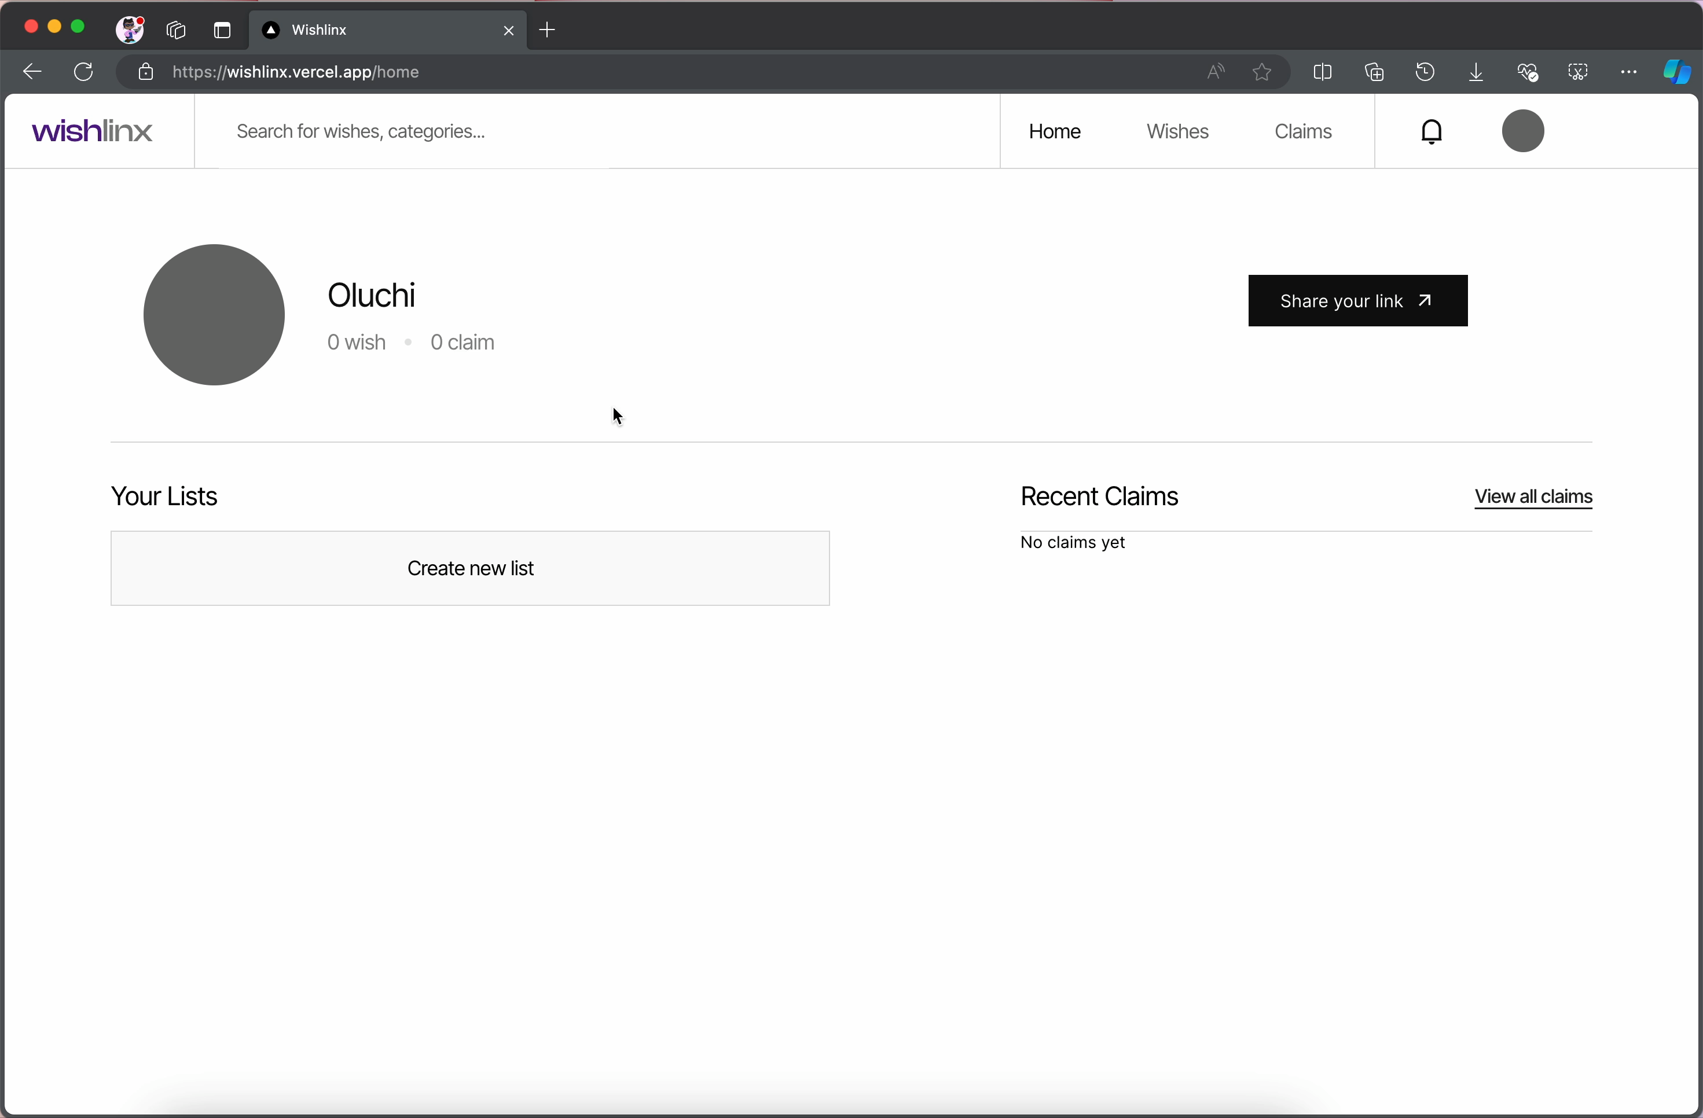

10
Live Demo

